Slide 1
PROJECT-BASED LEARNING
PHASE-II EVALUATION
RESQ
Intelligent Disaster Rescue & Emergency Response Simulator
“Algorithms That Save Lives”
Team ID: DSCPP-III-2026-T117 | Mentor: Dr. Prabhdeep Singh
Department of Computer Science & Engineering
Graphic Era (Deemed to be University), Dehradun
Academic Session 2026–27

Slide 2
Team & Mentor Details
Team Information
Team ID: DSCPP-III-2026-T117
Semester: 3rd
Sections: ML-1, ML-2, ML-4, DS-2
Domain: Emergency Response (DSA + OOP)
Team Members
Vanya Rathi (Leader) — 2510383410
Akshat Dobhal — 2510370353
Ayush Kandwal — 2510380235
Nitin Singh — 2510370229
Mentor
Dr. Prabhdeep Singh
Interactions completed: 02

Slide 3
Problem Statement & Motivation
Problem Statement
During a disaster, many people need help at once. We want to model who should be reached first and which open road a rescue team should take.
Motivation
Requests do not all have the same urgency.
Road closures can change the best route.
A simple model lets us inspect these decisions.
Target Users / Stakeholders
Students learning DSA and OOP
Mentors reviewing algorithm behaviour
Training demonstrations—not real dispatch

Slide 4
Objectives
Project Objectives
Register victims and rank requests by urgency.
Find a least-cost open route using Dijkstra.
Assign a free team and track rescue status.
Compare the native C/C++ design with the web demo.
Check queues, blocked roads and completion counts.
Key Objective
Show a complete simulated rescue from victim entry to completion.

Slide 5
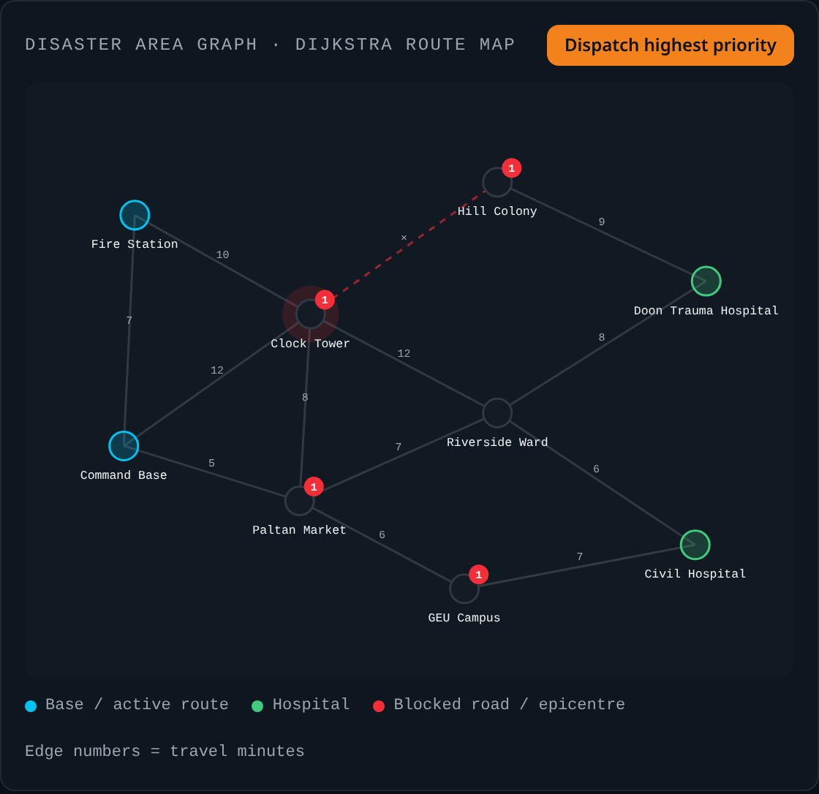
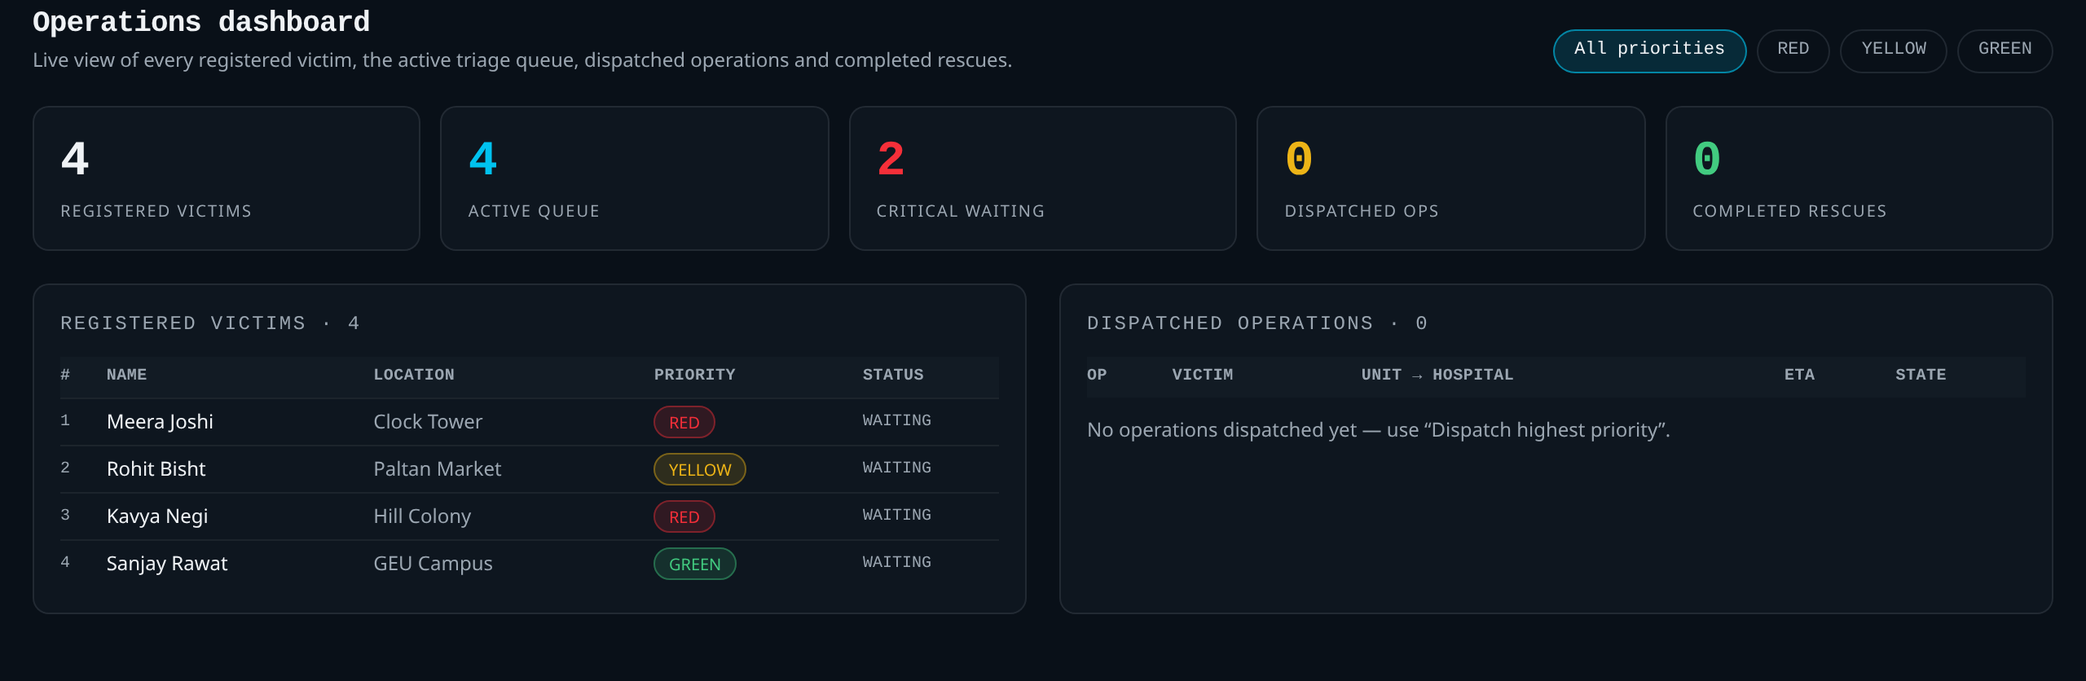
Phase-II Solution & Demonstration
Our Approach
Victim entry → urgency queue → available team → Dijkstra route → movement → status update. No team or no route: the request stays pending.
Dashboard: registered, waiting, active and completed rescues
Route map

Slide 6
Integration of PBL Course Concepts
Course / concept | How we use it | Implementation
Data Structures in C | Linked list, FIFO queue, max-heap, stack and graph | Native C
Dijkstra and BFS | Least-cost open route and reachable areas | C + TypeScript
OOPs with C++ | Classes, private state, inheritance and virtual dispatch | Native C++
Browser demonstration | Intake, queue, route map and dashboard | Separate TypeScript demo
Implementation distinction
Higher triage score means higher priority. The web demo is not the native C/C++ program.

Slide 7
System Architecture / Workflow
Victim
input
Triage
queue
Team
assignment
Dijkstra
route
Status +
dashboard
Major Components
Intake and queue
Weighted disaster map
Dispatcher and operation tracker
Data / Control Flow
Score the request and select a free team.
Exclude blocked roads from the route.
Update the victim, team and counts on completion.

Slide 8
Technology Stack & Methodology
Technology Stack
Native: C data structures and C++ classes
Web: React and TypeScript
Map: weighted graph with SVG display
Current-session data; no shared database
Development Methodology
Start with the Phase-I design.
Build and inspect queue and graph modules.
Make rescue decisions visible in the demo.
Test small cases before full scenarios.
Limits
We use simulated costs and scores, not live GPS or a medically validated triage model.

Slide 9
Phase-II Progress & Team Contribution
Progress Achieved
Victim intake, queue, route map and dashboard built.
Fixed heap test: RED, YELLOW, GREEN.
Dijkstra costs: 5, 6, 7 to Market, Clock, Fire.
Costs are simulated—not real response times.
Member | Contribution
Vanya Rathi | Architecture, triage logic, integration and documentation
Akshat Dobhal | Linked list, queue, priority queue and stack
Ayush Kandwal | Graph module, BFS and Dijkstra routing
Nitin Singh | C++ classes, scenario testing, dashboard and reports

Slide 10
Roadmap, Expected Outcomes & References
Roadmap & Expected Outcomes
Phase I: proposal and design
Phase II: prototype development
Phase III: boundary tests and complete scenario runs
Compare FIFO with priority scheduling and native with browser results.
Prepare a user guide and class diagram.
References
Cormen et al., Introduction to Algorithms, 4th ed.
Dijkstra, “A note on two problems in connexion with graphs,” 1959.
Stroustrup, The C++ Programming Language, 4th ed.
NDMA India — ndma.gov.in
Thank You
Questions & Suggestions

